Slide 1
Clustering by fast search and find of density peaks

Slide 2
Machine learning
Supervised learning
regression
classify
Unsupervised learning
clustering
Reinforcement learning

Slide 3
K-means or K-medoids
Determining objective function(Contour coefficient or …)
(1)Given k-value
(2)Clustering by minimum distance
(3)Update clustering centers
(4)Repeat steps (2) and (3) until condition convergence

Slide 4
K-means
Advantage
Disadvantage
k-value
Iterative properties ,time complexity O(knt)
It is difficult to find non-spherical clusters.
Dependence on distribution

Slide 5
DBSCAN
Given thresholds eps and minPts
(1)Pick an un-visited point p, if p_density ≥ minPts: C ← p, N ← q_neighborhoods; else p marked as a noise
(2)For q ∈ N, if q_density ≥ minPts: C ← q, N ← q_neighborhoods; else q marked as a noise point
(3)Repeat (2), until N=∅
(4)Repeat (1)-(3), until all points assigned to a cluster or marked as noise points

Slide 6
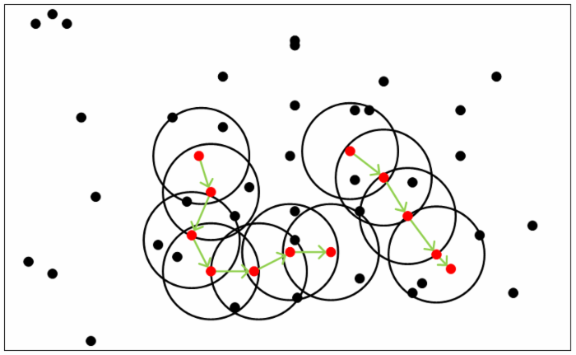
DBSCAN
minPts = 5

Slide 7
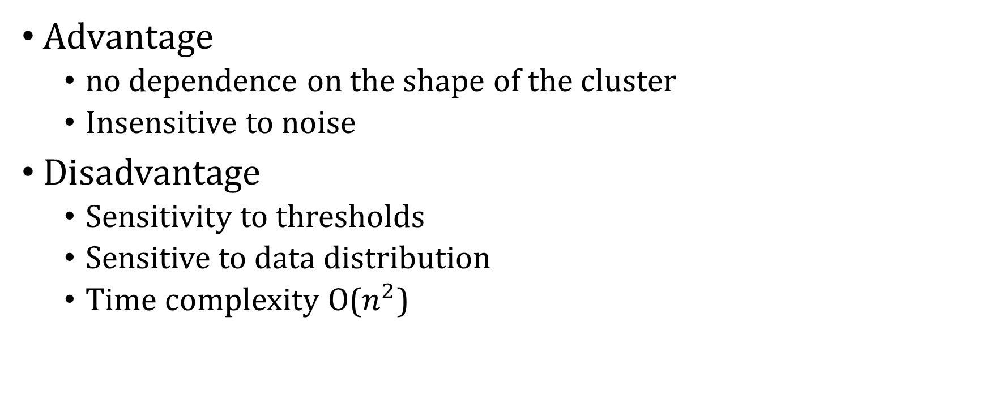
DBSCAN
Advantage
no dependence on the shape of the cluster
Insensitive to noise
Disadvantage
Sensitivity to thresholds
Sensitive to data distribution
Time complexity O($n^{2}$)

Slide 8
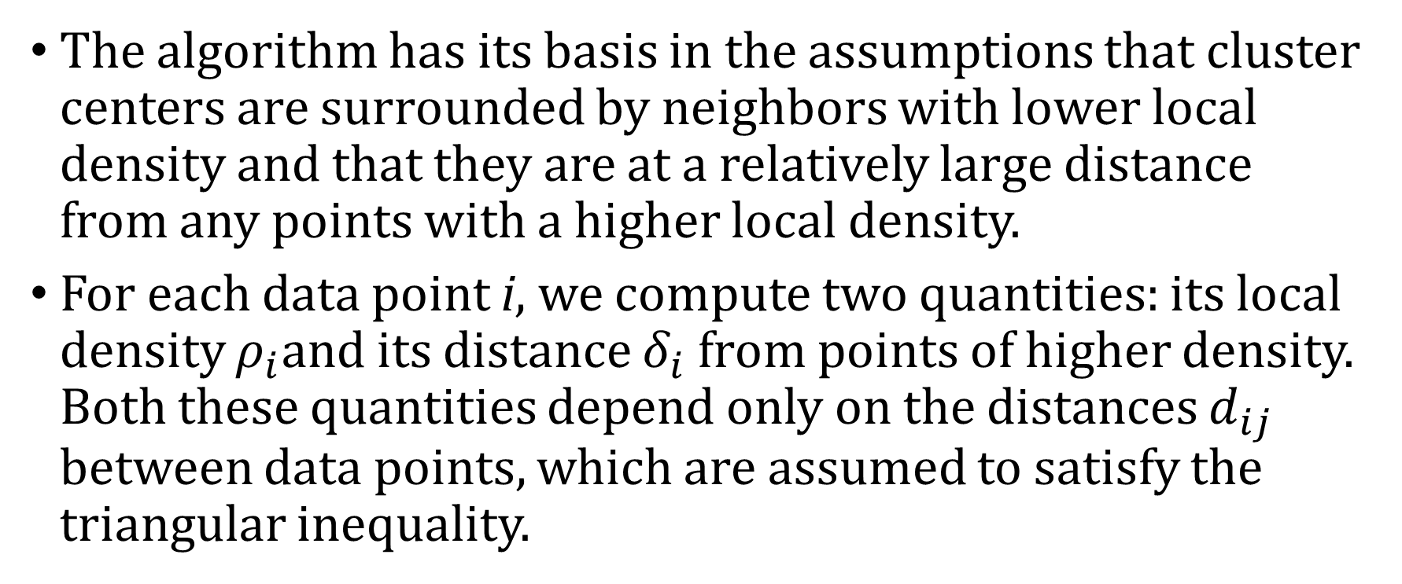
DPC
The algorithm has its basis in the assumptions that cluster centers are surrounded by neighbors with lower local density and that they are at a relatively large distance from any points with a higher local density.
For each data point i, we compute two quantities: its local density ${\text{ρ}}_{i}$and its distance ${\text{δ}}_{i}$ from points of higher density. Both these quantities depend only on the distances $d_{ij}$ between data points, which are assumed to satisfy the triangular inequality.

Slide 9
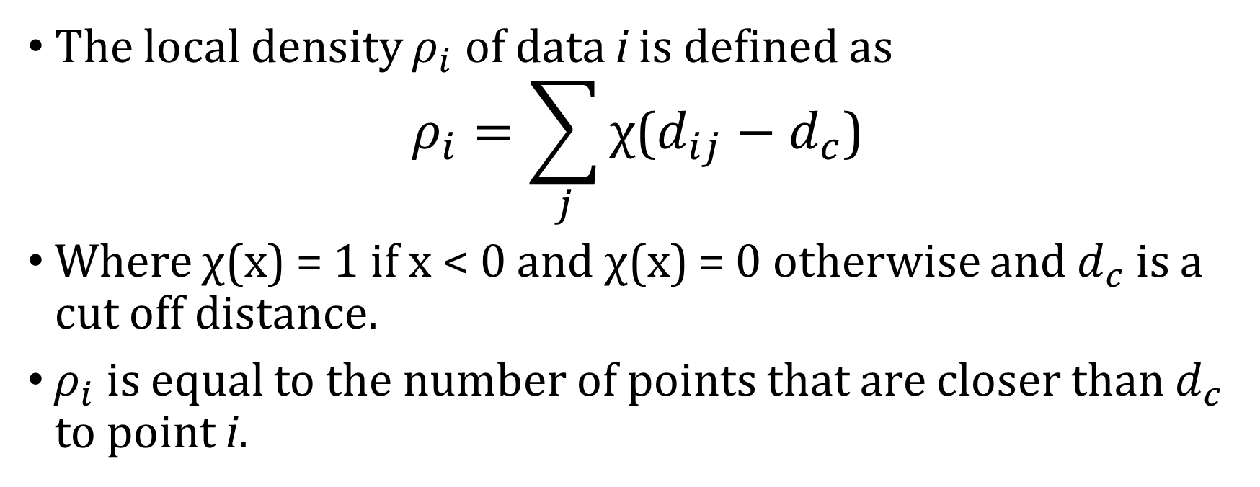
DPC
The local density ${\text{ρ}}_{i}$ of data i is defined as
$${\text{ρ}}_{i}=\sum_{j}{\text{χ}\text{(}d_{ij}−d_{c}\text{)}}$$
Where χ(x) = 1 if x < 0 and χ(x) = 0 otherwise and $d_{c}$ is a cut off distance.
${\text{ρ}}_{i}$ is equal to the number of points that are closer than $d_{c}$ to point i.

Slide 10
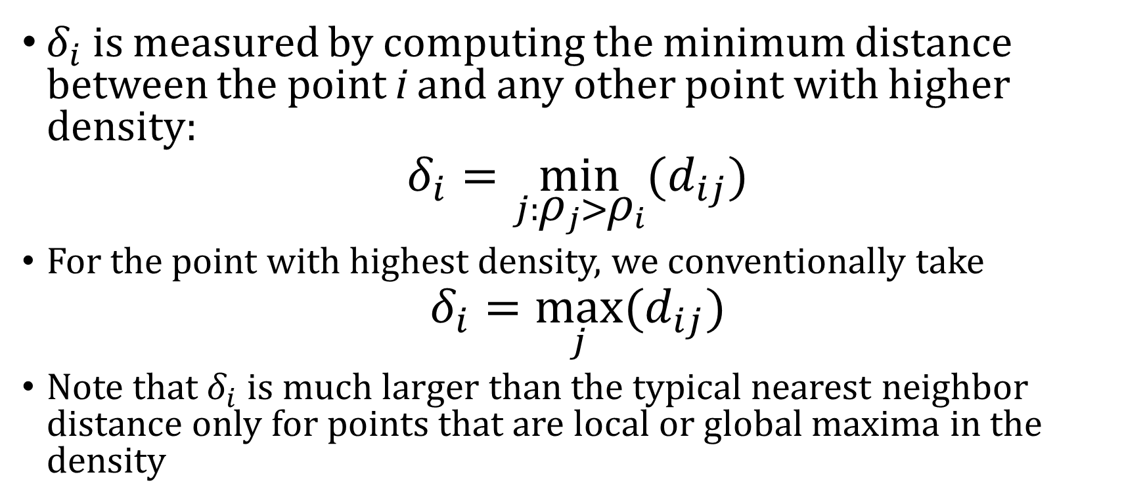
DPC
${\text{δ}}_{i}$ is measured by computing the minimum distance between the point i and any other point with higher density:
$${\text{δ}}_{i}=\min_{j:{\text{ρ}}_{j}>{\text{ρ}}_{i}}{(d_{ij})}$$
For the point with highest density, we conventionally take
$${\text{δ}}_{i}=\max_{j}{(d_{ij})}$$
Note that ${\text{δ}}_{i}$ is much larger than the typical nearest neighbor distance only for points that are local or global maxima in the density

Slide 11
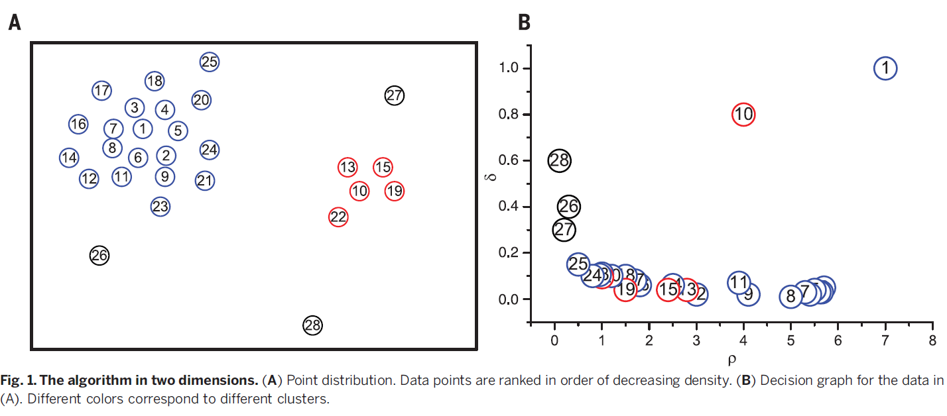
DPC

Slide 12

DPC
The selection principle of $d_{c}$
Principles for determining noise

Slide 13
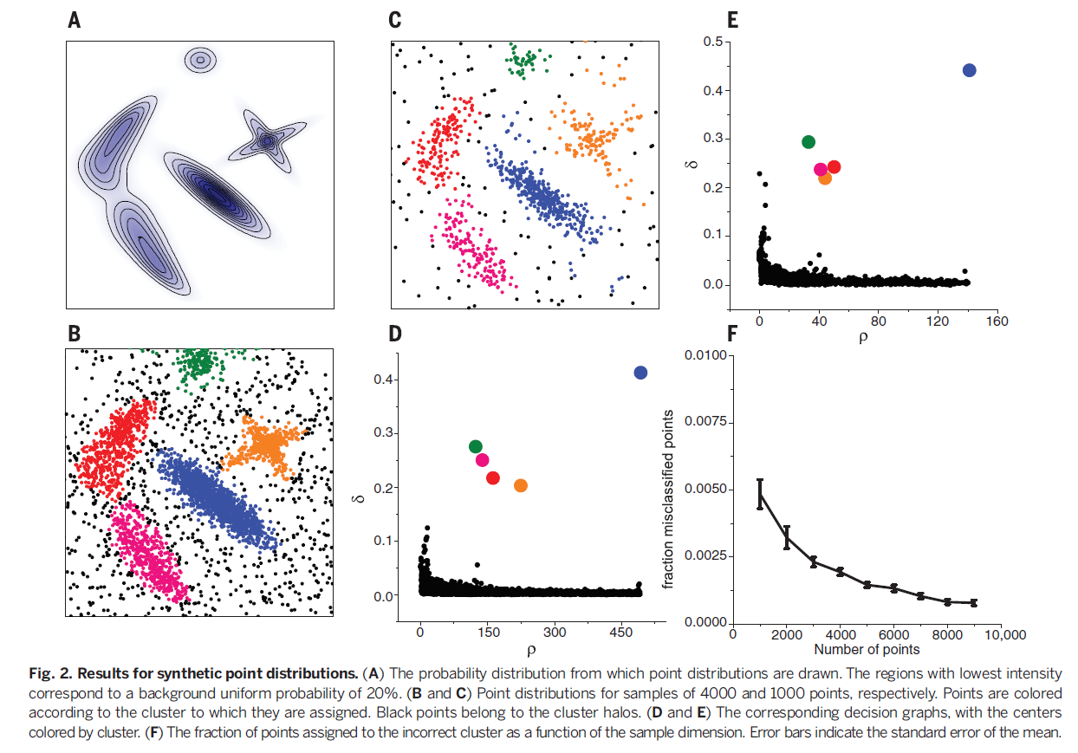

Slide 14
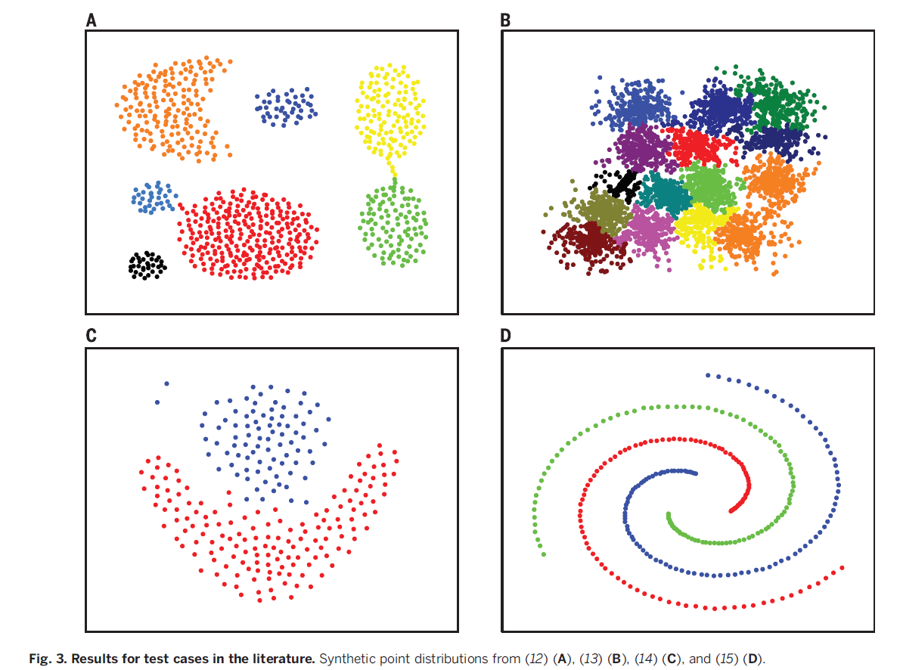

Slide 15
